Slide 1
Object-Oriented Techniques

Slide 2
CONTENTS
- Object-Oriented Techniques
Creating and Using an Opaque Pointer
Polymorphism in C

Slide 3
Object-Oriented Techniques
C is not known for its support of object-oriented programming
However, you can use C to encapsulate data using an opaque pointer and to support a certain
level of Poly-morphic behavior
By hiding a data structure’s implementation and its supporting functions, the user does not
need to know how the structure is implemented
Hiding this information will reduce what the user needs to know and thus reduce the application’s
complexity level
Polymorphic behavior helps make an application more maintainable

Slide 4
Creating and Using an Opaque Pointer
An opaque pointer can be used to effect data encapsulation in C
One approach declares a structure without any implementation details in a header file
Functions are then defined to work with a specific implementation of the data structure in an
implementation file
A user of the data structure will see the declaration and the functions’ prototypes
However, the implementation is hidden
Only the information needed to use the data structure is made visible to the user
If too much internal information is made available, the user may incorporate this information and
become dependent on it
Should the internal structure change, then it may break the user’s code

Slide 5
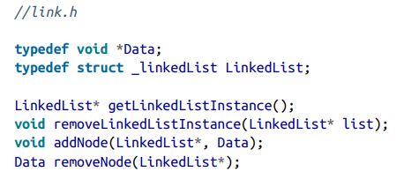
Creating and Using an Opaque Pointer
Develop a linked list to demonstrate an opaque pointer
The details of the linked list’s internal structure and its supporting function are not available
to the user
- The only aspects of this structure are provided through a header file

Slide 6
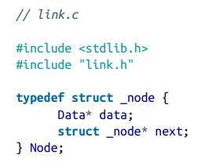

Creating and Using an Opaque Pointer
The linked list’s implementation is found in a separate file called link.c
This is followed by the _linkedList structure’s definition

Slide 7
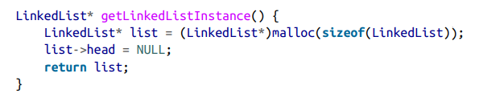
Creating and Using an Opaque Pointer
The second part of the implementation file contains implementations of the linked list’s
four supporting functions
The first function returns an instance of the linked list

Slide 8
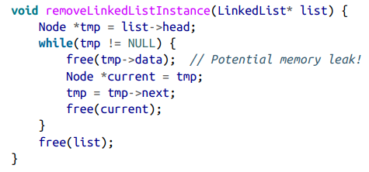
Creating and Using an Opaque Pointer
It will free each node in the linked list, if any, and then free the list itself
This implementation can result in a memory leak if the data referenced by the node contains pointers
One solution is to pass a function to deallocate the members of the data

Slide 9
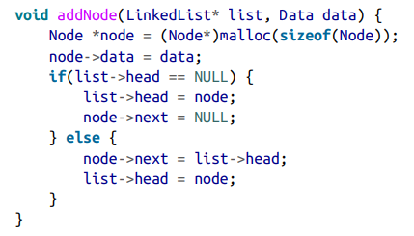
Creating and Using an Opaque Pointer
The addNode function adds the data passed as the second parameter to the linked list specified
by the first parameter
Memory is allocated for the node, and the user’s data is associated with the node
In this implementation, the linked list’s nodes are always added to its head

Slide 10
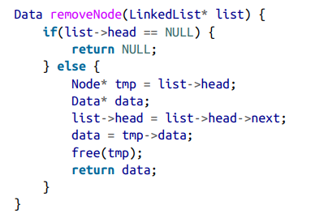
Creating and Using an Opaque Pointer
The removeNode function returns the data associated with the first node in the linked list
The head pointer is adjusted to point to the next node in the linked list
The data is returned and the old head node is freed, releasing it back to the heap

Slide 11
Polymorphism in C
Polymorphism in an object-oriented language such as C++ is based on inheritance between a base
and a derived class
Since C does not support inheritance we need to simulate inheritance between structures
The structure’s variable allocation order has a large impact on how this technique works
When an instance of a derived class/structure is created, the base class/structure’s variables
are allocated first, followed by the derived class/structure’s variables

Slide 12


Polymorphism in C
First, we allocate a structure to hold the function pointers for the structure
Next, integers are declared for an x and a y position

Slide 13
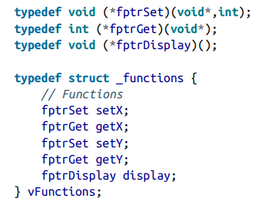
Polymorphism in C
When a function is executed against a class/structure, its behavior will depend on
what it is executing against
The fptrSet and fptrGet function pointers define the typical getter and setter functions for
integer type data

Slide 14
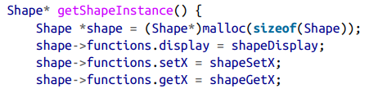
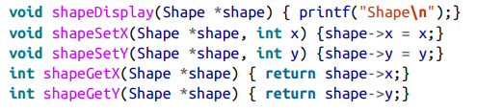
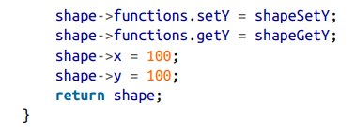
Polymorphism in C
The Shape structure has four functions designed to work with it
To assist in the creation of a Shape instance, we have provided a getShapeInstance function
It allocates memory for the object and the object’s functions are assigned

Slide 15
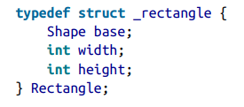
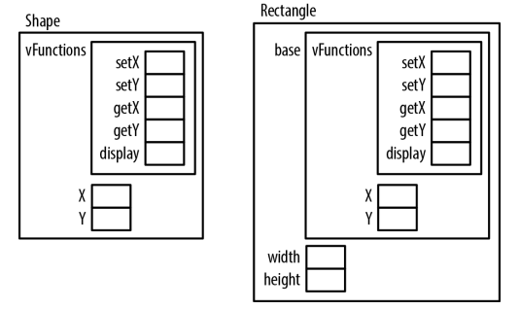
Polymorphism in C
Create a structure derived from Shape: Rectangle

Slide 16
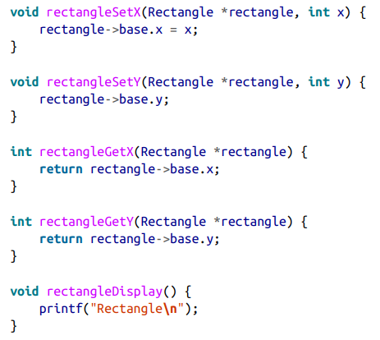
Polymorphism in C
Rectangle, like Shape, needs some functions associated with it
They are similar to those associated with the Shape structure, except that they use the
Rectangle’s base field

Slide 17
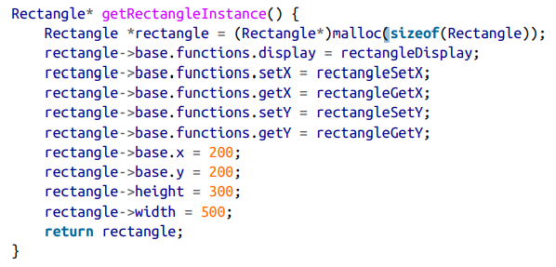
Polymorphism in C
The getRectangleInstance function returns an instance of a Rectangle structure

Slide 18
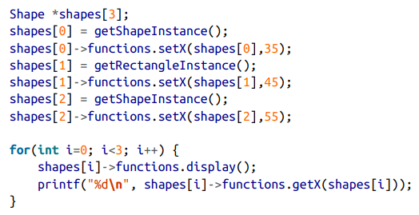
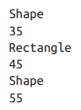
Polymorphism in C
While we created an array of Shape pointers, we created a Rectangle and assigned it
to the array’s second element
When we displayed the element in the for loop, it used the Rectangle’s function behavior and
not the Shape’s
The display function depends on the structure it is executing against

